Slide 1

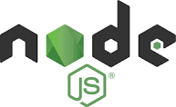

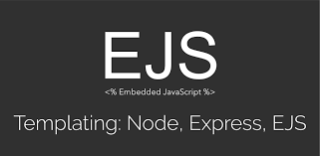


Web Programming 381
Server-side Programming using Node.js
mkwaira.t@belgiumcampus.ac.za
magorimbo.m@belgiumcampus.ac.za

Slide 2
Introduction: Subject Outcomes
At a glance
Subject Outcomes
Class Etiquette
Assessments
What should you already know
What should you have on your computer.

Slide 3
Introduction: Subject Outcomes
An exploration of the architecture of a web framework.
Comparison of frameworks, and their suitability for some business problem.
Setting up a project using a framework, for example Angular, Node and Express.
Installing and configuring dependencies.
Concepts of directives and data binding within a framework.
Fundamentals of routing and navigation within a framework.
An overview of web services and how web applications use data.

Slide 4
Introduction: Class Etiquette
Respect our time, and respect your peers.
Use MS Teams for interaction. Zoom Chat is for pertinent issues.
You will get an opportunity to ask questions during Q&A.
Read the material. You have additional notes on MS Teams.
The link for the class video will be made available.
Download AnyDesk for support.
Use both facilitators for the course.
Research is a skill! Learn it.

Slide 5
Introduction: Assessments for the subject
2 Projects (MS1 and MS2). To be completed in groups.
2 Tests
1 individual assignment

Slide 6
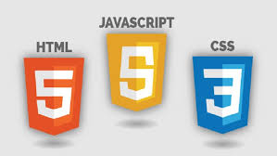
Introduction: Pre-requisite Knowledge

Slide 7
Introduction: Picking an IDE
Performance
Desirable Features: You will need a terminal in your IDE
Options that are available
My choice: Visual Studio Code (VS Code)

Slide 8
Useful Links
160 Curated Node.js Programming Tutorials on HackSource (Links to an external site.)Links to an external site.
Build Application with Node JS Complete Tutorial (Links to an external site.)Links to an external site.
Learn Node.js - Best Node.js tutorials | Hackr.io (Links to an external site.)Links to an external site.
Learn Node JS in a Week via Video Screencast (Links to an external site.)Links to an external site.
NodeSchool (Links to an external site.)Links to an external site.
Felix's Node.js Guide (Links to an external site.)Links to an external site.
Node Tuts (Links to an external site.)Links to an external site.
Node.js for Beginners (Links to an external site.)Links to an external site.
Web Development Bootcamp (Links to an external site.)Links to an external site. || Node Skills Course (Links to an external site.)Links to an external site.
Collection of tutorials and online courses on Node JS (Links to an external site.)Links to an external site.
The Net Ninja on Youtube (Links to an external site.)Links to an external site.
Node.js official documentation (Links to an external site.)Links to an external site.
Learn Node.js: A Beginner’s Guide (Links to an external site.)Links to an external site.

Slide 9
Exercise: Install VS Code

